Slide 1

Fitness Improvement Process
Avery Hutchinson | MBC 638 | Fall 2022

Slide 2
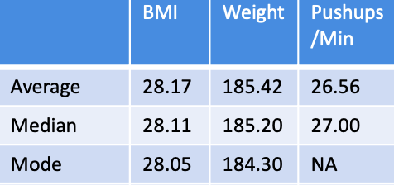
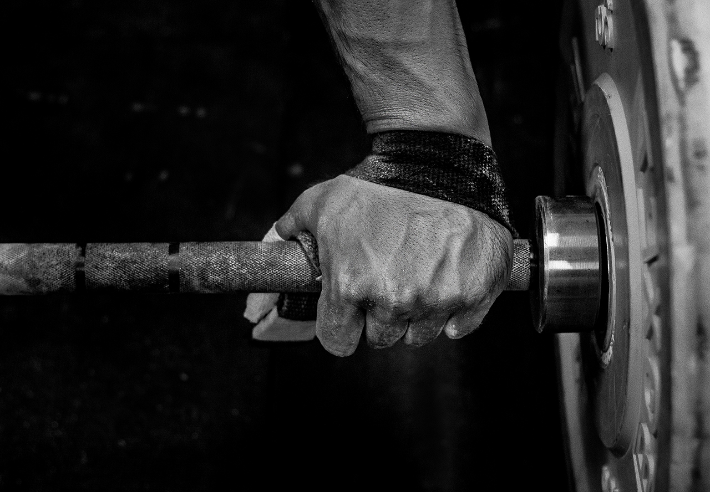
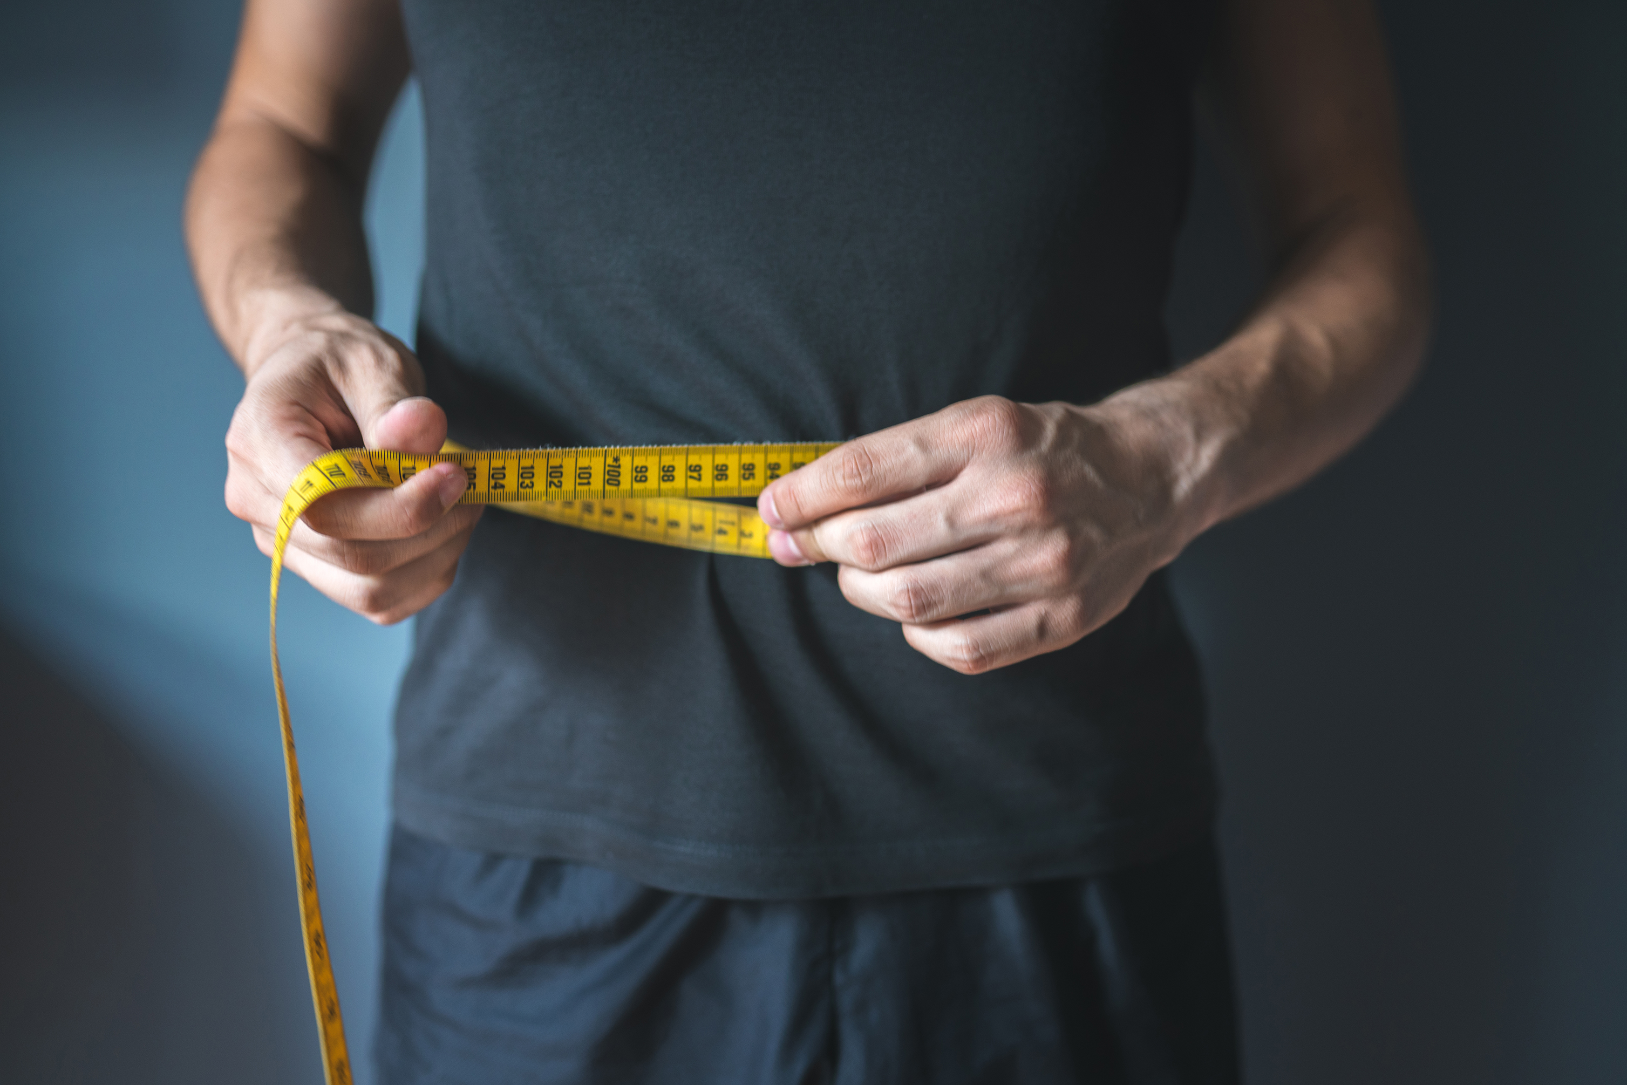
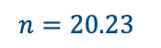

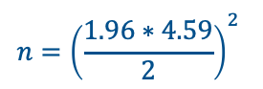
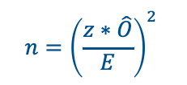
Process Improvement for fitness gains and bodyweight loss
Process owner: Avery Hutchinson
Key Dates --->
Launch:
Oct 6, 2022
Define:
Oct 6 – Oct 20
Measure:
Oct 20 – Oct 27
Analyze:
Oct 27- Nov 17
Improve:
Nov 17 – Dec 1
Control:
Dec 1 – Dec 8
DEFINE
MEASURE
ANALYZE
IMPROVE
Problem Statement:
Bodyweight and BMI are increasing but not due to any added muscle. This can be witnessed by the fact that strength and functional fitness level are increasing ; both most likely due to a scattered fitness plan and inconsistent gym sessions per week.
Goal:
Optimize strength level and weight loss by analyzing data collected and recorded from gym sessions throughout the week. Goals are defined as: increase 1 rep max lifts by at least 10 pounds at end of week 9, decrease mile time by at least 30 seconds at end of week 9, and decrease bodyweight by 4 pounds at end of week 9.
- Realized early on (week 4) that original training plan was inconsistent and was not leading to large lifting gains. Changes were made to the program to shift focus to spending more time lifting weights and less time on cardio
Sample size:
$$n={\left(\frac{z∗\hat{O}}{E}\right)}^{2}$$
$$n={\left(\frac{1.96∗4.59}{2}\right)}^{2}$$
$$n=20.23$$
Changes made to gym program were proven to be effective
CONTROL
Increase in strength measured by amount of weight lifted weeks 1- 10 and changes shown with line chart, histogram and trend lines
SQL increased from 2.3 to 3.0
SQL: 2.3
SQL: 3

Slide 3
Problem Statement: Strength and functional fitness is not increasing and might even be decreasing. Part of the issue is not being able to get to the gym for enough time or enough days of the week. When I do get to the gym, I try and split my time evenly between cardio and weightlifting. I know I have a problem because of weight gain as well as noticeable decrease in strength and gym stamina. Unpacking boxes, yardwork, or going on a run with the dog or playing with kids is getting harder and more tiring. Business impact: The problem should be fixed because I feel better when I am in better shape. I also want to be able to spend more time playing with my kids and dog because it makes us all happier. The problem is worth an estimated $100 a month for the gym membership which over time will end up being worth the cost because being stronger and healthier will allow me to get physical tasks like yard work done quicker which in turn will allow for more time in the day to be productive in other places. Success will be measured by overall bodyweight and BMI change, as well as change in strength measured by an increase or decrease in 1 rep max weight lifts and functional fitness movements. Some Descriptive Statistics:
DEFINE
Process map:
Improve fitness level
by losing weight
and getting
measurably stronger
 | BMI | Weight | Pushups/Min | Crunches/Min | Pullups/Min | Mile time | Deadlift 1Rep Max | Front squat 1 Rep Max | Bench Press 1 Rep Max
Average | 28.17 | 185.42 | 26.56 | 70.44 | 14.89 | 11.84 | 108.67 | 83.44 | 87.78
Median | 28.11 | 185.20 | 27.00 | 70.00 | 14.00 | 11.54 | 110.0 | 82.00 | 90.00
Mode | 28.05 | 184.30 | NA | 68 | 14 | NA | 110 | 75 | 90
Range | .56 | 5.4 | 14 | 19 | 10 | 2.85 | 27 | 32 | 30
SD | .18 | 1.23 | 4.59 | 5.72 | 3.02 | 0.86 | 7.91 | 10.78 | 9.64
Variance | .03 | 1.51 | 21.03 | 32.78 | 9.11 | 0.75 | 62.50 | 116.28 | 92.94
Goal: Optimize strength level and weight loss by analyzing data collected and recorded from gym sessions throughout the week. Goals are defined as: increase 1 rep max lifts by at least 10 pounds at end of week 9, decrease mile time by at least 30 seconds at end of week 9, and decrease bodyweight by 4 pounds at end of week 9. If the defined goals are reached by the end of 9 weeks, I will consider my process successful.

Slide 4
DEFINE
Questions About the Process Stratification Factors Measurements
X Variables
Do 1 rep/maxes increase with more lifting time? |  | Time available to exercise | Total minutes spent in gym
Does weight decrease as fitness gets better? |  | Amount of weight in pounds able to be lifted safely | Minutes spent on cardio
Does it matter how many days a week I go to the gym? |  | Treadmill availability | Minutes spent on weightlifting
Does time spent working on cardio effect mile times? |  | Accurate weight in dumbbells available to use | Weight in pounds lifted
Does it matter how long I spend in the gym? |  | Weightlifting bench availability | Weight in pounds for bodyweight
Is weight impacted by time and/or days spent in gym? |  | Squat rack availability | Mile time measured in minutes
Does day of week matter in terms of getting to the gym? | Improved strength and decreased body weight | Access to weightlifting log/phone application | number of pull ups, crunches and pushups per minute
Is BMI effected by bodyweight? | (Output Y) | Uninterrupted time for fitness testing | Max weight able to be lifted for 1 repetition only then failure (1 RM)
Do pullups increase with increased weightlifting time? |  | Consistent fitness testing environment | Body Mass index (BMI) = weight (lb) / [height (in)] ² x 703
Does BMI vary as greatly as body weight? |  | Gym hours open | Number of repetitions (Reps)
Does upper body strength increase more or less than lower body strength? |  | Clear weather for fitness testing if unable to do in gym | Average time spent in gym
Is strength effected by illness? |  | Health (unable to make it to gym when sick) | Average time spent weightlifting and/or on cardio
 |  | Business in home/work/school schedule | Range of weights lifted per body movement
 |  |  | Number of days spent at gym in a week
All tests and measurements were compared to baseline data taken 1 week prior to start of gym sessions
SQL: Before ( weekly strength test, functional tests, and BMI test)
 | Defect opportunities per unit: D = 9 (4 strength tests, 4 functional tests, 1 BMI test per week)
 | Units produced per day: U = 3 ( set of strength tests, set of functional tests, BMI test)
 | Total possible defects per day: D x U = 28
 | Total actual defects per day: A = 6 (6 test results were not higher than baseline)
 | Defects per opportunity rate: A / DU = DPO = 21.4%
 | Defects per million opportunities: DPO x 1,000,000 = DPMO = 214,000
 | SQL = 2.3 Yield = 78.8%

Slide 5
Data Measurement Plan
MEASURE
Operational Definitions:
BMI: Body mass index is a measure of a person's height and weight calculated to determine if a person’s weight is healthy or not. The formula used is (weight (lb) / [height (in)]² x 703).
Weight: bodyweight measured in metric pounds using same scale in same location everyday
1 RM: “1 rep max” is a weightlifting term to record the maximum weight a person can lift for only one repetition before failure
Time: measured in minutes and used to define length of time spent on cardio and weightlifting sessions
Deadlift/Bench press/Front Squat/Dumbbell overhead press/ Pushups/ crunches/ Pull ups/ Mile time: All variable types of body movements, weightlifting movements, or cardio exercise used to determine strength and overall fitness levels.
Performance Measure | Data Source and Location | How Will Data Be Collected | Who will Collect Data | When will Data be Collected | Target Sample Size
Week Number (1-9) | Calendar | Excel | Myself | Every Monday | 9 weeks
Day of Week (Monday – Sunday) | Calendar | Excel | Myself | Every Day | 63 Days
Gym Attendance | Weightlifting log | In weightlifting log/phone app, then to Excel | Myself | Every Day | 36 sessions
Body Weight | Bathroom Scale | Weighed with scale and copied into Excel | Myself | Every Day | 63 data points
Body Mass Index (BMI) | Calculated using BMI formula from CDC (weight (lb) / [height (in)]² x 703) | Calculated and copied into Excel | Myself | Wednesdays and Sundays | 18 data points
Dumbbell Overhead Press 1 Rep/MAX (DB O/P 1RM) | Gym performance | In weightlifting log/phone app, then copied to Excel | Myself | After gym sessions | 9 data points
Front Squat 1 Rep/Max (F/S 1RM) | Gym performance | In weightlifting log/phone app, then copied to Excel | Myself | After gym sessions | 9 data points
Deadlift 1 Rep/Max (Deadlift 1RM) | Gym performance | In weightlifting log/phone app, then copied to Excel | Myself | After gym sessions | 9 data points
Bench Press 1 Rep/Max (B/P 1RM) | Gym performance | In weightlifting log/phone app, then copied to Excel | Myself | After gym sessions | 9 data points
Fitness Test (max pushups, crunches and pullups per minutes, 1 mile run) | Counted myself and timed using Garmin fitness watch | In weightlifting log/phone app, then copied to Excel | Myself | Every Sunday | 9 data points for each category
Time spent in gym (Cardio, Lifting and Total Time) | Garmin fitness watch | In weightlifting log/phone app, then copied to Excel | Myself | After gym sessions | 36 data points for each category

Slide 6
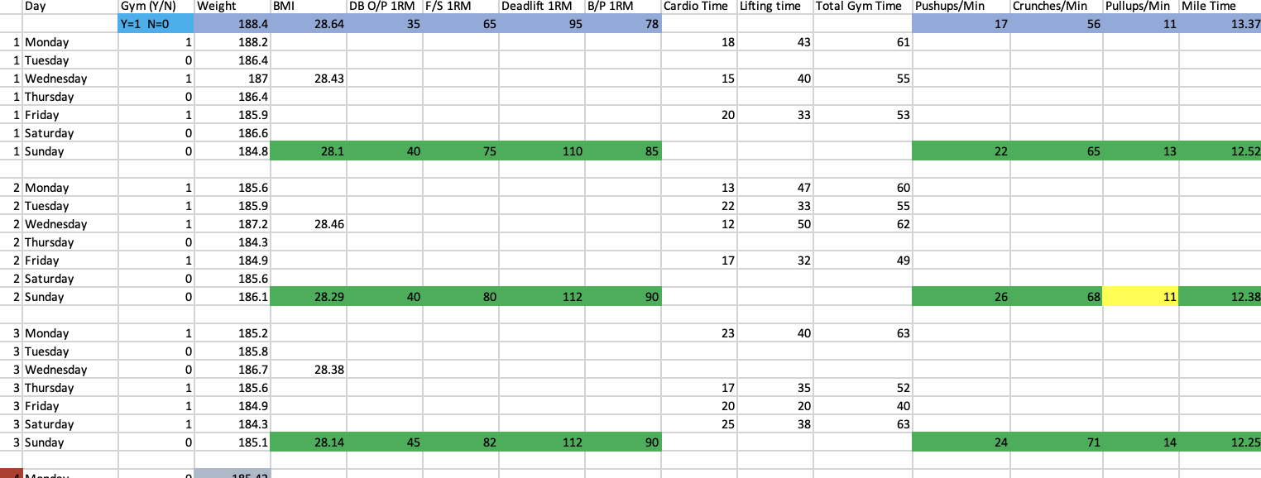
MEASURE
The types of data I collected were my own and they were time and yield values. Cardio time, weightlifting time and mile time were all recorded per gym session or mile test. Weight was recorded in two different ways. The first way was recording bodyweight daily as an input and the second was recording the amount of weight lifted (yield) during fitness tests.
The data was a mixture of continuous and discrete. Continuous data included week number, day of week, if I went to the gym or not (yes =1, no = 0), number of pushups, crunches and pullups per minute.. The rest of the data was discrete: Weight, BMI, and Time.
I collected 9 weeks worth of bodyweight data on a daily basis because bodyweight fluctuates so much from day to day that I felt it was important to collect daily in order to see the big picture of increase or decrease overall. I then collected gym session data on the days where I went to the gym which was 3 days a week on average. I also recorded the results of several fitness tests(a collection of weightlifting movements and a timed mile run) on Sundays every week in order to see if my strength output increased, decreased, or stayed the same over the 9 weeks. It was also important to record because I could see the difference between the before stage (weeks 1-4) and the after stage (weeks 5-9) after I had made changes to my weightlifting and gym session programs.
The data was collected a few ways. The week number and day of week was collected from a calendar app. My bodyweight was collected daily from a bodyweight scale and recorded into an excel workbook every day. My BMI was calculated on Wednesdays and Sundays using a BMI formula (weight (lb) / [height (in)]² x 703) and recorded into the same excel workbook as bodyweight. The weightlifting movements were first recorded into a weightlifting phone app as they were performed in the gym, and the results were transferred into the excel workbook. Time spent on cardio and weightlifting were recorded using a stopwatch on my Garmin watch and time was rounded to the nearest whole minute or half minute. The mile run time was collected using the same stopwatch on my Garmin watch. The times were recorded in my weightlifting phone app and then transferred into the excel workbook.

Slide 7
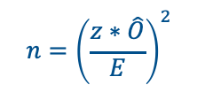
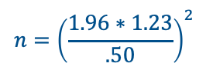

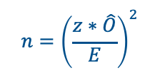
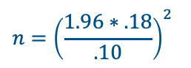



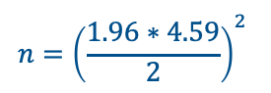
MEASURE & ANALYZE
For pushups, I did not gather enough samples and that could cause my data to be skewed. One week I might have not been as sore or tired from my gym sessions and my pushups were confident and strong. Vice versa, I could have just done an intense workout on a Saturday and then tested my pushups on Sunday and I could’ve struggled greatly. The more samples I have, the more confident I can be that circumstances and chance don’t have a great influence on my data allowing me to be confident that if I were to replicate the test in the future, the results would be very similar.
Assuming I want a 95% confidence and I am okay with a margin of error of .50 pounds, my ideal sample size for bodyweight would be 23.24 which rounded up would be 24 samples.
$$n={\left(\frac{z∗\hat{O}}{E}\right)}^{2}$$
$$n={\left(\frac{1.96∗1.23}{.50}\right)}^{2}$$
$$n={23.24}^{}$$
Measurement error can come from many places. In my data set I discovered 6 instances of measurement error which were simple cases of incorrectly inputting data. I missed a decimal place when transferring over one of my mile times. I wrote 2 numbers in the wrong column and had to back track all my data to find it and fix it. And, I was sick in week four and didn’t weigh myself for 3 days. In order to fix that error and those missed data points, I averaged my weight for all 9 weeks and used that number to fill in the missing days, but ultimately, that was not the actual data.
Measurement errors that I did not catch and are difficult to correct perfectly would have to do with my bodyweight data. Bodyweight fluctuates greatly throughout the day and daily for people. I took precautions to try and get as accurate and consistent measurements as possible by measuring my weight with the same scale, placed in the same spot every day. I also stepped om the scale 2-3 times and recorded the number that showed up the most since there was a high chance of the measurement being off by one or two tenths of pound depending on how I stood on the scale. However, I was not able to weigh myself at the same time every morning which could have thrown off some of the results. I also did not weigh myself everyday on an empty stomach until I realized the potential for possible errors this could cause, but that correction wasn’t until late in week 3.
I averaged a measurement error of approximately .50 pounds of body weight which I was satisfied with. I also figure I averaged 1 to 2 seconds of measurement error regarding my mile time because there was the possibility of hitting the start or stop button a second or two early or late. I could’ve used fancy equipment with an auto start timer and a video camera but in all honesty, I wasn’t that dedicated to my mile time. 1 to 2 seconds of ME was satisfactory.
Assuming I want a 95% confidence and I am okay with a margin of error of .10, my ideal sample size for BMI would be 12.45 which rounded up would be 13 samples.
$$n={\left(\frac{z∗\hat{O}}{E}\right)}^{2}$$
$$n={\left(\frac{1.96∗.18}{.10}\right)}^{2}$$
$$n=12.45$$
Assuming I want a 95% confidence and I am okay with a margin of error of 2 pushups, my ideal sample size for Pushups would be 20.23 which rounded up would be 21 samples.
$$n={\left(\frac{z∗\hat{O}}{E}\right)}^{2}$$
$$n={\left(\frac{1.96∗4.59}{2}\right)}^{2}$$
$$n=20.23$$

Slide 8
ANALYZE
Histogram of the fitness test results from week 1-9. There was a slight decline in week 4 and 5. This is due to me being sick during week 4 and not quite back to normal in week 5. Week 5 was also when I changed my fitness program and started focusing more on weightlifting and less on cardio. We can then see a steady incline in weights lifted as well as a decrease in mile time, all of which suggest the changes I made were beneficial to my end goal.
Scatter plot with trend lines for each fitness test. We can see similar results in this plot as we did in the histogram above. What is more clear in this scatter plot is the upward trend line for all weightlifting movements as well as the very slight decline in mile time. This tells me very simply that overall, I progressed in my mile times and my strength.

Slide 9
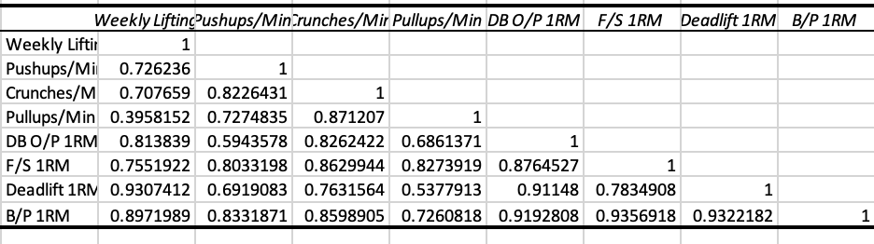
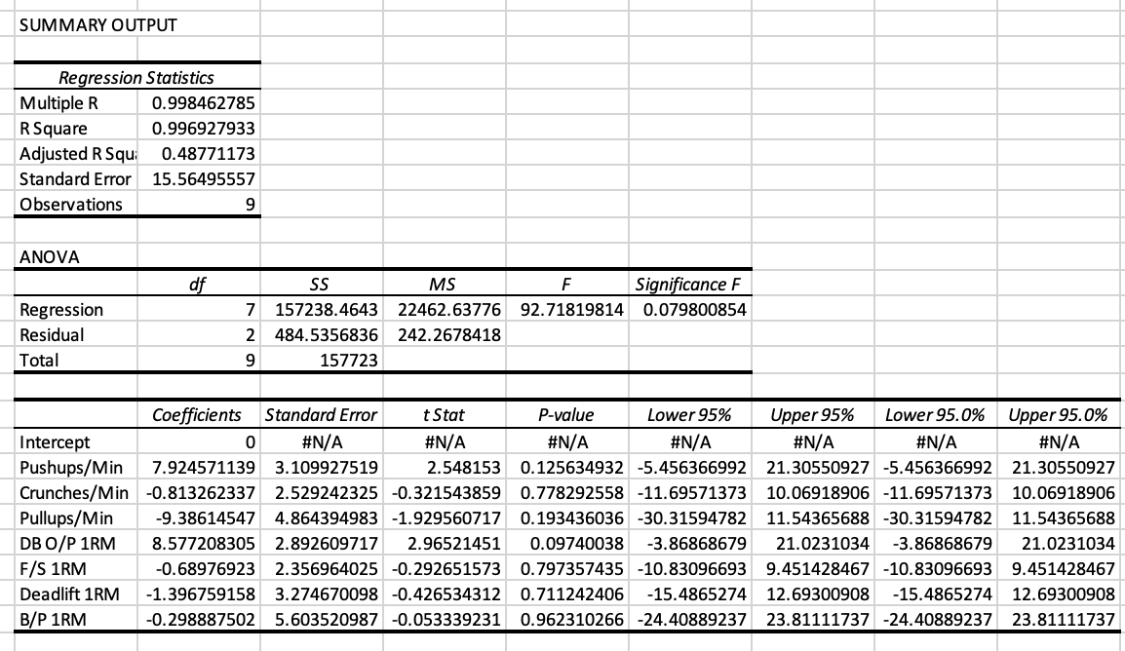
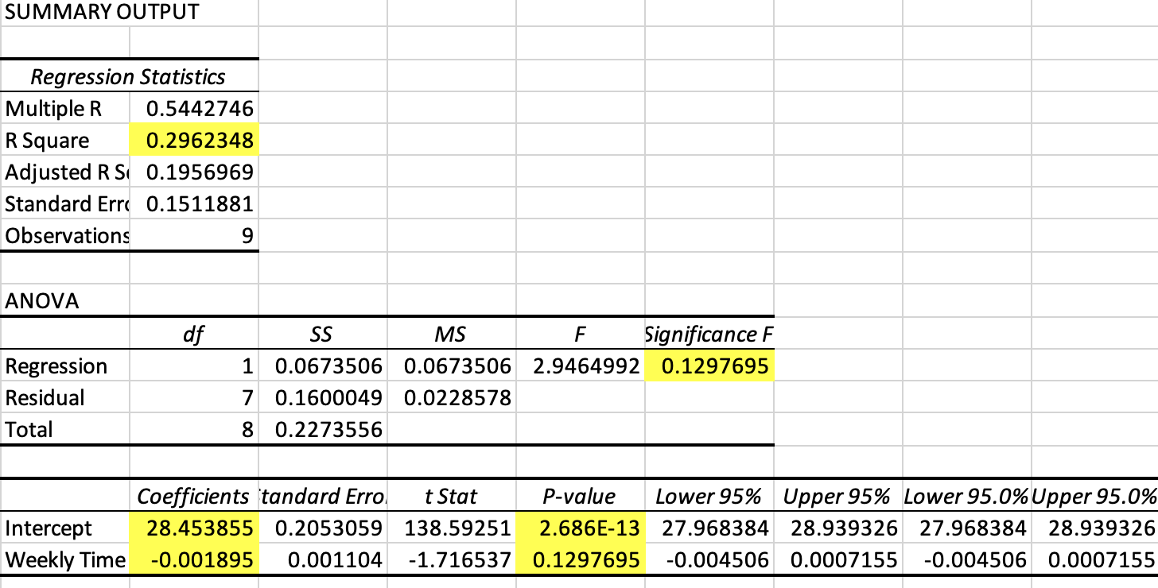
ANALYZE
Correlation Matrix
Provides levels of correlation between inputs. Greatest correlation is.9356 (between bench press and front squat) and .9307 (weekly lifting time and Deadlift).
Multiple Regression Analysis
When attempting linear regression to determine if weekly time spent in gym affects BMI, we can see that the resulting R² does not indicate a good fit. If there was correlation between BMI and time spent in the gym, we would expect the R²value to be greater than 0.77. Additionally, the significance of F is much higher than an expected alpha level of 0.05 and therefore we cannot say anything more about this relationship.
When performing a multiple regression analysis, the significance of f still returns too high at .079 and the corresponding p-values for the coefficients are also much higher than an alpha level of .05. Unfortunately, nothing else can be said for these relationships either.

Slide 10
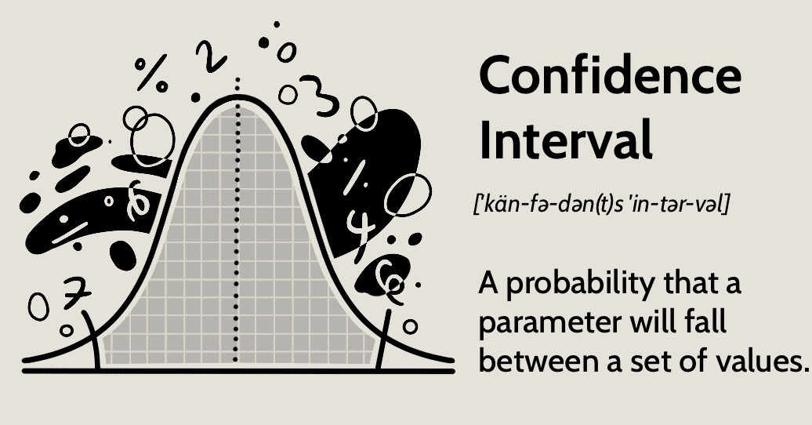
ANALYZE
 | BMI | Weight | Pushups/Min | Crunches/Min | Pullups/Min | Mile time | Deadlift 1Rep Max | Front squat 1 Rep Max | Bench Press 1 Rep Max | DB O/P 1 Rep Max
Average | 28.17 | 185.42 | 26.56 | 70.44 | 14.89 | 11.84 | 108.67 | 83.44 | 87.78 | 40.89
Confidence.norm = | 0.08 | 0.30 | 3.00 | 3.74 | 1.97 | 0.56 | 3.70 | 7.04 | 6.30 | 5.16
Conf. Interval Range | (28.08, 28.25) | (185.12, 185.72) | (23.56, 29.55) | (66.70, 74.18) | (12.92, 16.86) | (11.28, 12.41) | (103.50, 113.83) | (76.40, 90.49) | (81.48, 94.08) | (37.19, 44.59)
Confidence Intervals: with alpha level .05

Slide 11
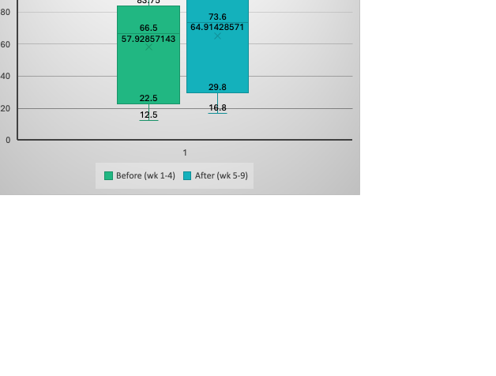
IMPROVE
After week 4, I could see that my strength was not increasing as much as I wanted it to. I considered my workout program and realized that I was spending a lot of time on cardio however, one one of my fitness tests had to due with cardio which was the time mile run. In week 5 I switched up my gym focus and dedicated more of my session to weightlifting and less to my cardio. I ultimately was dedicated around 11 to 12 minutes a session for cardio which allowed to me to focus more on speed as opposed to endurance and ultimately lead to my mile time getting faster. The change also led to an overall decrease in bodyweight as well as BMI, which was one of my goals.
In the above scatter plot, we can see a negative trend in my BMI over the 9 weeks. I measured BMI twice a week in order to have more data points to see the trend better. While the decline only has a range of -0.7, it is important to note that BMI does not change quickly. This is also why I kept a log of my bodyweight daily, which can be seen in the scatter plot below. In comparison my body weight had a great range change of -5.4 pounds over 9 weeks. A person loses 1 pound of bodyfat per week on average when working out. However, it is also important to know that when you are weightlifting, the body puts on weight in muscle. Therefore, an average of a half pound bodyweight loss per week is a good start in my opinion.
We can see in the boxplot on the left that my average amount of weights lifted increased in the last half of the 9 weeks.

Slide 12
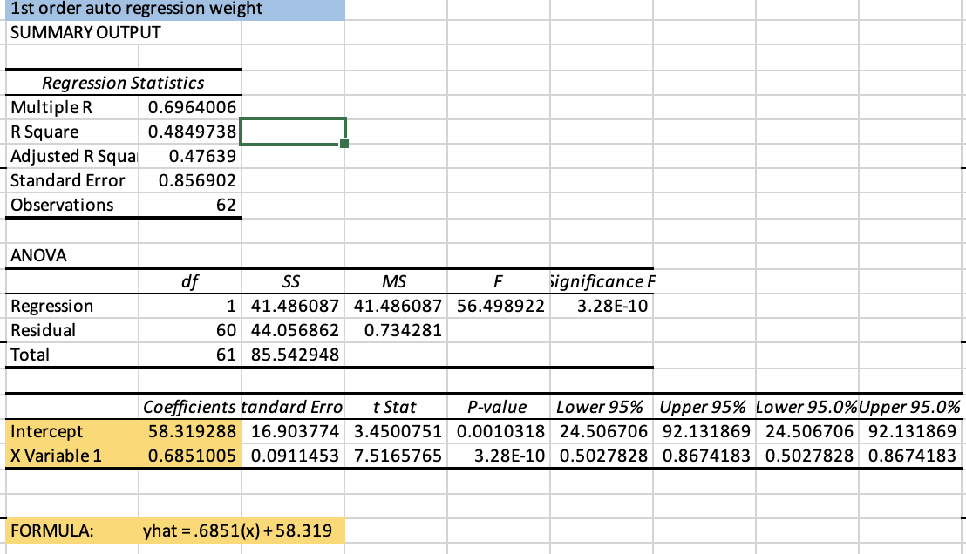
CONTROL
Time Series:
On the right is the summary output for first auto regression on the bodyweight data. By using the formula yhat = .6851(x) + 58.319, I can plug in the bodyweight value for the previous day into x, and I can forecast what my weight will be for the next day. This isn’t as helpful on a day-to-day basis but going forward I could take bodyweight average a week at a time and I could then forecast a week ahead to see when I might reach my goal weight.
Exponential smoothing on the left shows the actual data and forecasted data in reference to body weight. The high increase around data point 23 was just after I was sick in the beginning of week 4. I lost some weight from not eating but then gained it back quickly the next week in water weight and trying to re-coup nutrients. After the spike, my weight started to level out again and started to gradually decrease.

Slide 13
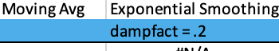
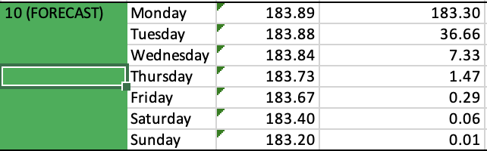
CONTROL
SQL improved from 2.3 to 3 after changes were made and defects were identified and corrected. There is still a great amount of improvement that can happen in order to raise the SQL level even more.
SQL: After ( weekly strength test, functional tests, and BMI test)
 | Defect opportunities per unit: D = 9 (4 strength tests, 4 functional tests, 1 BMI test per week)
 | Units produced per day: U = 3 ( set of strength tests, set of functionsl tests, BMI test)
 | Total possible defects per day: D x U = 28
 | Total actual defects per day: A = 2 (2 test results were not higher than baseline)
 | Defects per opportunity rate: A / DU = DPO = 7.1%
 | Defects per million opportunities: DPO x 1,000,000 = DPMO = 71,000
 | SQL = 3 Yield = 93.3%
Above is the forecast for week 10 using Moving average and exponential smoothing techniques on the bodyweight data. Using a damping factor of .2 made sure to put more weight on the more recent data points, which were the ones recorded after I had made the change to my gym program and focused more on weight lifting and less on cardio. As we can see, if things were to continue steadily in the gym, I would continue to lose about 7/10ths of a pound.
What have I learned? / What is next?
Using all the discovered information, I am confident that I am on the right track in focusing more on weightlifting and less on cardio. I can hold steady and keep doing what I am doing OR I can start to add in different changes, little by little to see how those effect my weight loss and strength increase. By changing or adding one thing at a time or tweaking different variables, over time I will be able to optimize my process and my gains should grow exponentially. The next thing I would want to try is to add in calorie tracking and/or intermittent fasting and see what the effects are.

